Slide 1
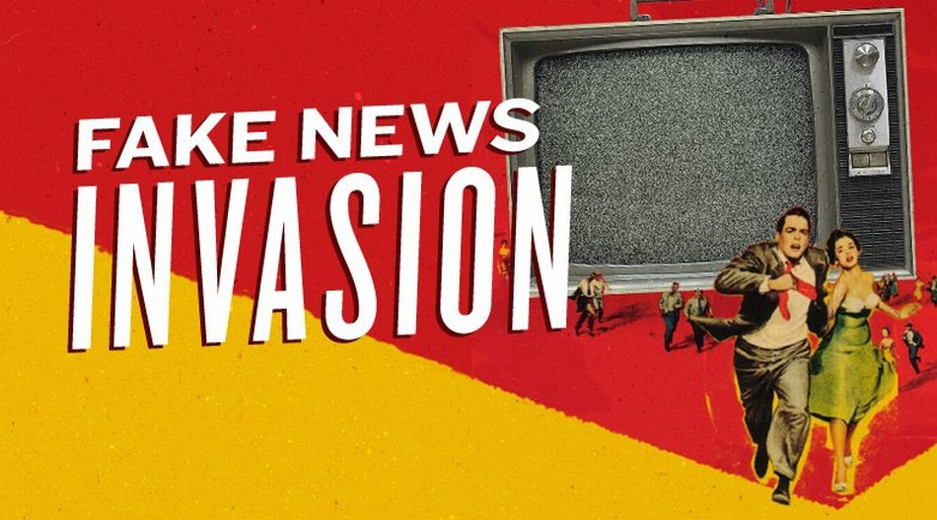
Notes:
Based off a 150+ slide deck that really gets into it, so know that this is just part of the conversation and that we could talk about this for HOURS

Slide 2
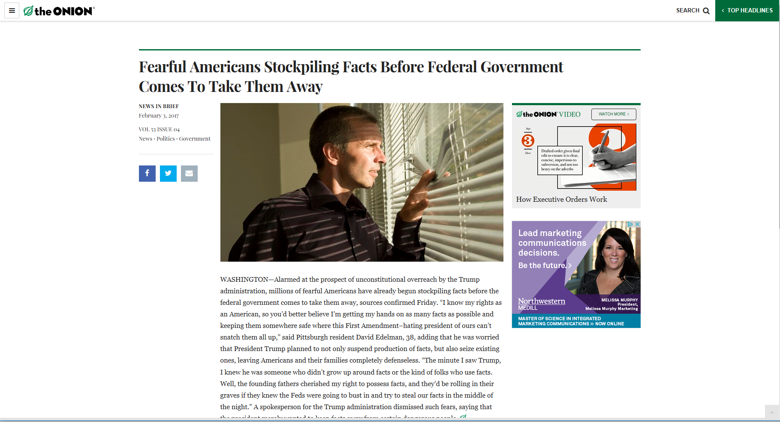
Notes:
So, fake news isn’t new. Propaganda and satire have both existed for as long as we can remember. But fake news– both the content itself and the term– have become big buzzwords (searches for the term itself have skyrocketed), and so we need to talk about what it is, what it isn’t, and what to do about it.
http://www.theonion.com/article/fearful-americans-stockpiling-facts-federal-govern-55219

Slide 3
“If we are not serious about facts and what’s true and what’s not, and particularly in an age of social media when so many people are getting their information in sound bites and off their phones, if we can’t discriminate between serious arguments and propaganda, then we have problems.”
(Barack Obama)
Notes:
To start, it helps to acknowledge, as former President Obama has here, that fake news is a problem. It’s not just a problem for publishers or social networks or the media. It’s a problem for us as people and us as society. If we can’t differentiate between what is real and what is fake, we are facing dire times.
https://www.nytimes.com/2016/11/18/world/europe/obama-angela-merkel-donald-trump.html

Slide 4
Fake News …
is blatantly and verifiably false information.
is intentionally created to deceive, trick, or confuse.
is most often disseminated from sites created solely for fake news stories.
is clickbait intended to generate advertising revenue.
is confusing and hard to define because the term is often misused.
is NOT always easy to identify at first (or second) glance.
is NOT just a problem in the U.S.
is NOT the same as unverified news.
is NOT the same as opinion, biased, slanted, or tilted news.
is NOT just news you don’t like or don’t want to be true, based on your personal beliefs.
Notes:
Here’s what fake news is:
Blatantly false and fack-checkable
Created with the intention to deceive, trick ,or confuse
It comes most often from domains set up with this sole purpose
It is a major ad revenue opportunity
And it’s confusing
Here’s what it’s not:
It’s not always easy to identify, as many domains sound legit (like DenverGuardian or ABC.com.co
It’s not the same as unverified news
It’s also not the same as opinion, biased, etc.
And it’s especially not just news you don’t like or don’t want to be true.
https://points.datasociety.net/how-do-you-deal-with-a-problem-like-fake-news-80f9987988a9#.czuhbqefi

Slide 5
“We’ve used this phrase so many times in the past two months that it’s almost lost meaning — partly because it can mean so many different things.
Depending on who you talk to, ‘fake news’ may refer to satirical news, hoaxes, news that’s clumsily framed or outright wrong, propaganda, lies destined for viral clicks and advertising dollars, politically motivated half-truths, and more.”
(FiveThirtyEight.com)
Notes:
But like we said, fake news is also tricky to define. Why? Because everyone has their own opinion on what it is, and the original meaning has been diluted and redefined.
https://fivethirtyeight.com/features/fact-checking-wont-save-us-from-fake-news/

Slide 6
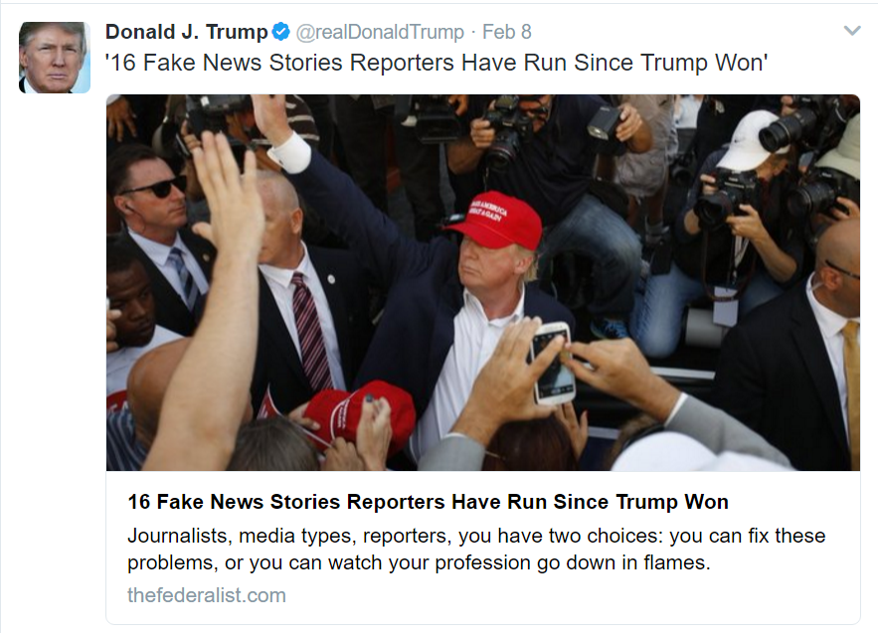
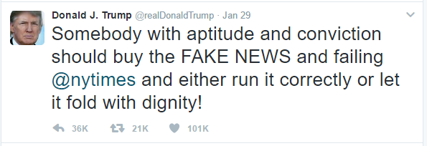
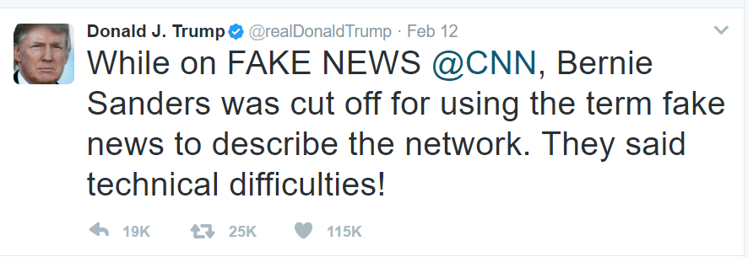
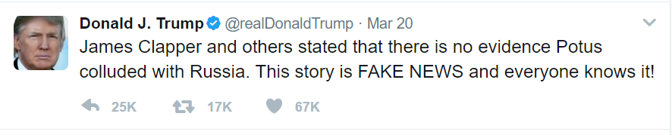
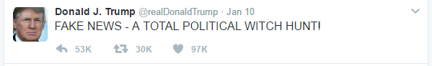
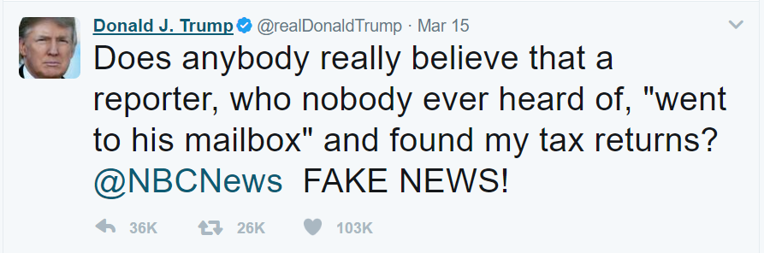
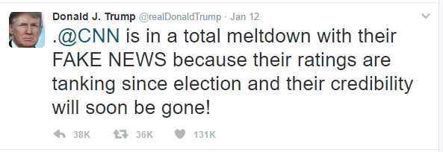
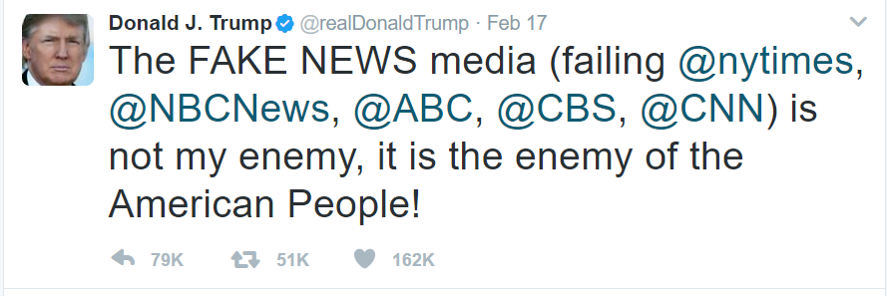
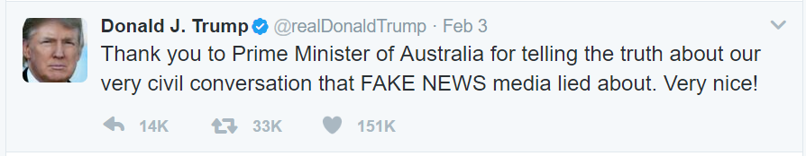
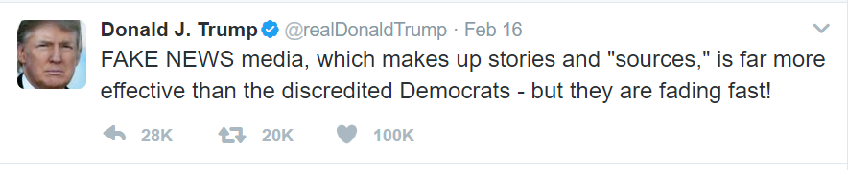
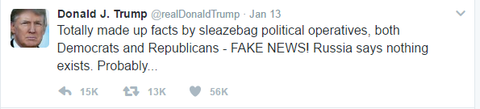
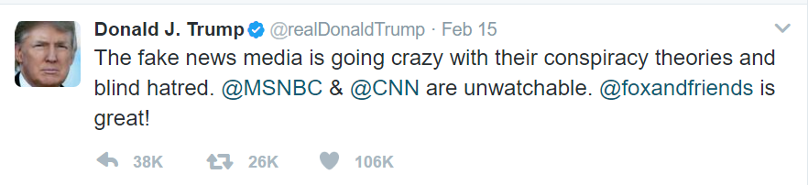
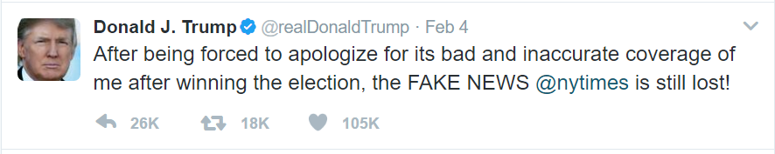
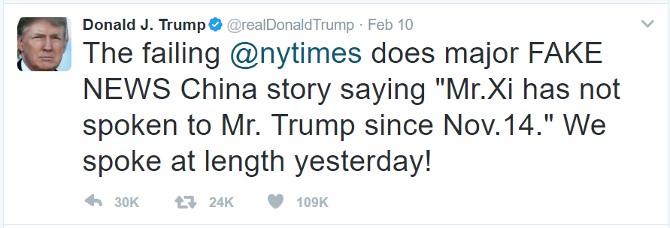
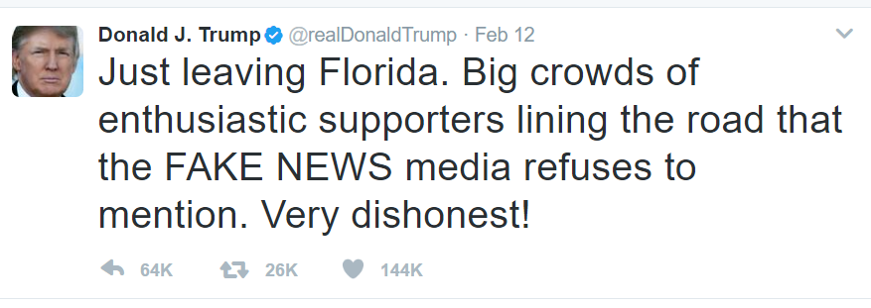
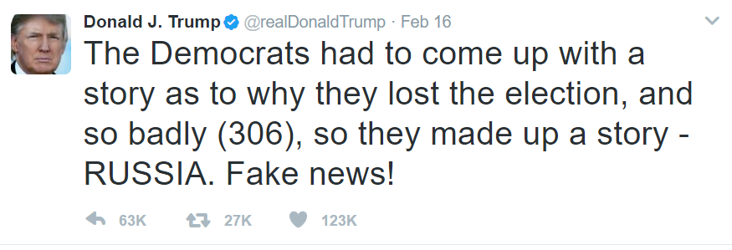
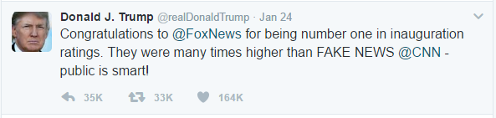
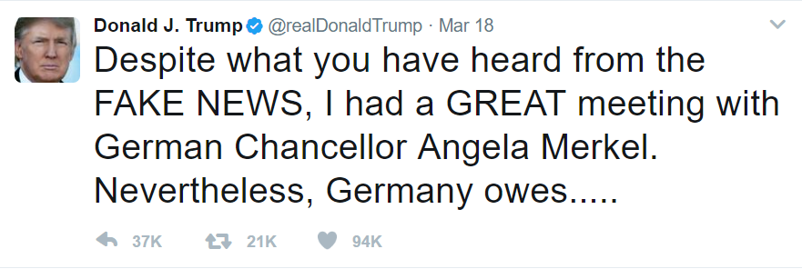
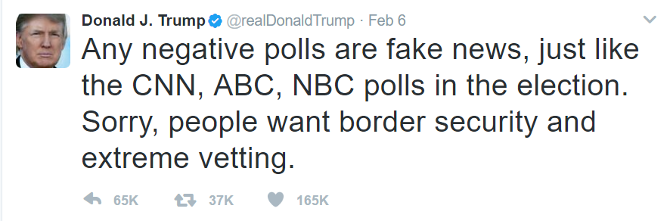
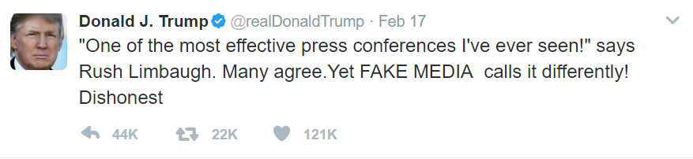
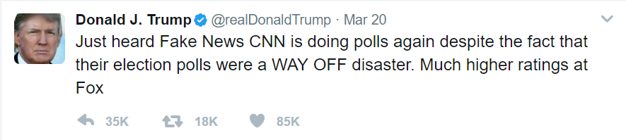
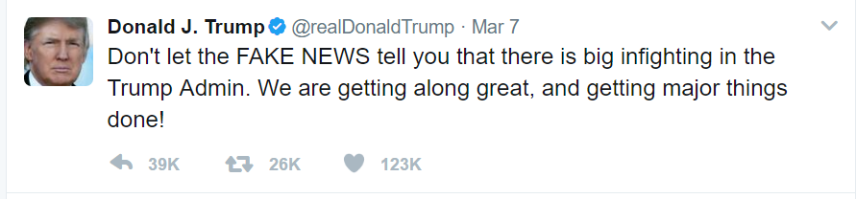
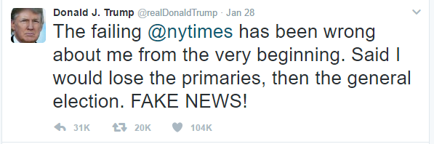
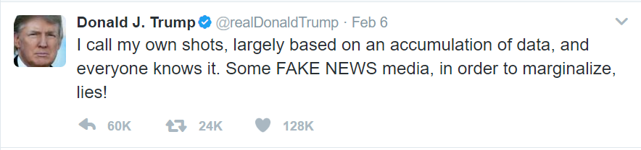
Notes:
The problem, of course, is that the term is being used incorrectly, especially by a few specific people. And that epidemic is spreading, as other world leaders have used the term in this incorrect way this week.
(This is not a political rant. This is a point about language, and it’s power. When the President is misusing this term, most often to refer to news that he doesn’t like, it’s meaning gets even more diluted.)
(Also, none of these are examples of fake news.)

Slide 7
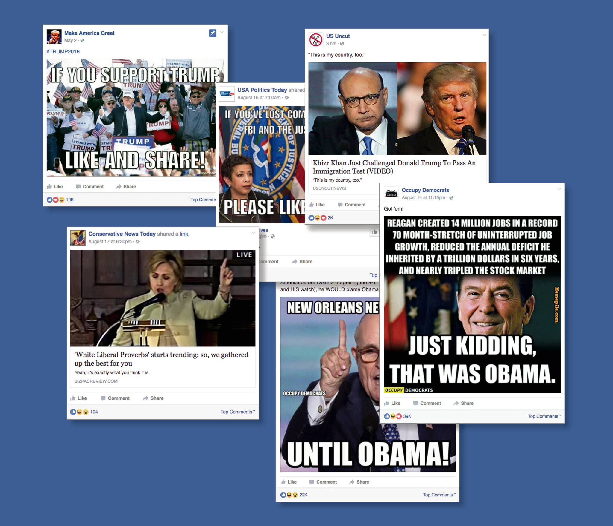
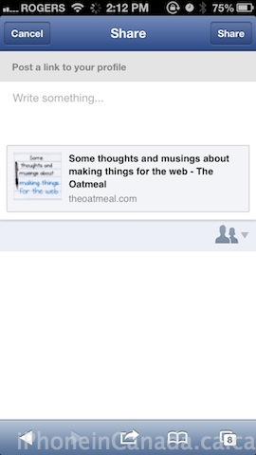
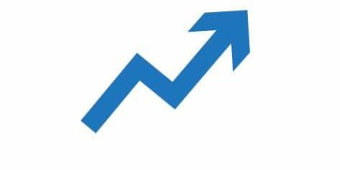
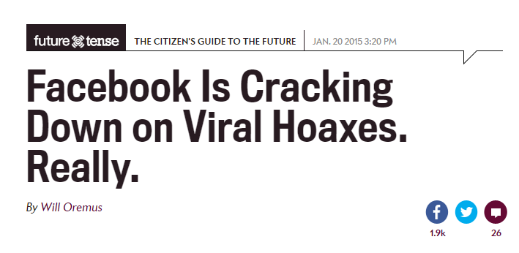
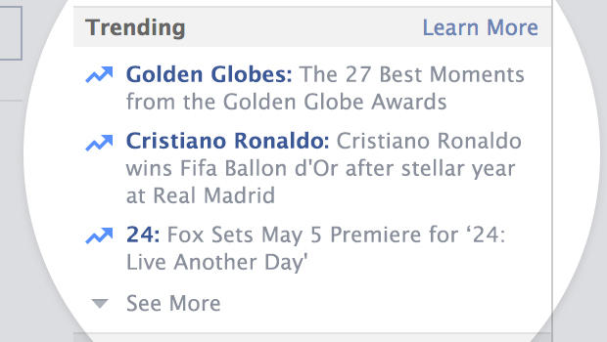
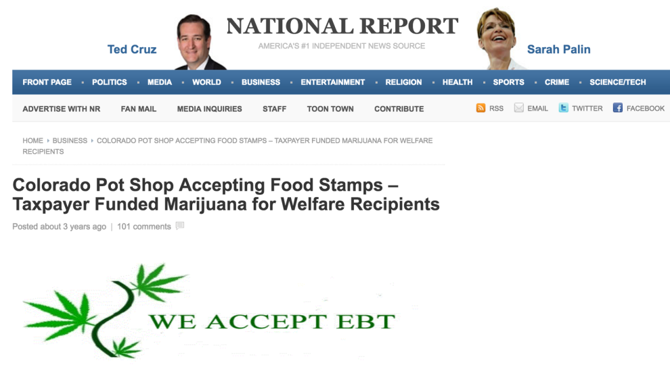
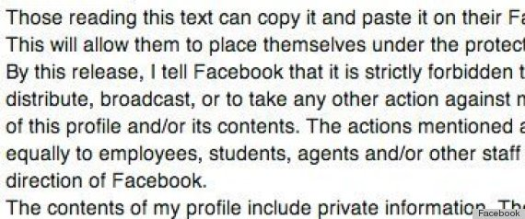
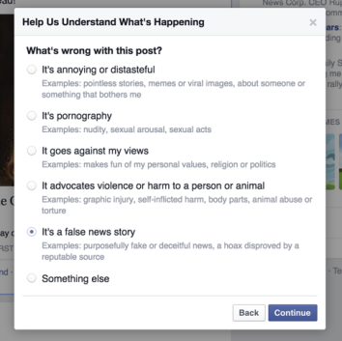
2012
2013
2014
2015
2016
2017
Notes:
So let’s look at how we got here:
November 2012: Facebook launches mobile sharing, changing the dynamic of how and what we share.
February 2013: Jestin Coler, one of the fake news kings, debuts National Report, spearheading a fake news stampede
March and August 2013: Facebook launches hashtags and Trending Topics to compete with Twitter
2014: Hoaxes on Facebook, already a problem, continue to grow
2015: Facebook says they’ll do something about the hoaxes, launches self-reporting tool that made literally no impact
And then, 2016, when these sites and Facebook pages pushing fake news exploded; links to fake news sites are everywhere and their traffic is driven primarily by social media shares
And then…this happened…
https://www.buzzfeed.com/alexkantrowitz/2016-election-blew-up-in-facebooks-face?bftwnews&utm_term=.uxL597ol3P#.tfvDJe95x8
https://www.nytimes.com/2016/08/28/magazine/inside-facebooks-totally-insane-unintentionally-gigantic-hyperpartisan-political-media-machine.html

Slide 8
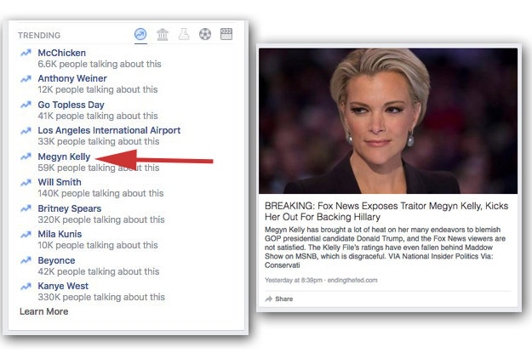
Notes:
On August 29, 2016, Facebook’s algorithm surfaced a fake trending story that Fox News had fired Megyn Kelly. In and of itself, this wouldn’t be a big deal beyond the obvious falsehood. Except… it happened on the heels of a GigaOm report that Facebook’s human editors had been suppressing conservative news from Trending Topics…and that it came after the company publicly tweaked its algorithm to “improve” Trending by making it more automated and fired all the human editors it had previously highlighted…
Again, the story itself was 100% fake news, crafted from a fake news site and published to Facebook, where it was shared hundreds of thousands of times. It took Facebook almost the entire day to fix the issue. And then, everything began to crumble…
http://www.slate.com/articles/technology/future_tense/2016/08/how_facebook_s_trending_news_feature_went_from_messy_to_disastrous.html?wpsrc=sh_all_dt_tw_top

Slide 9
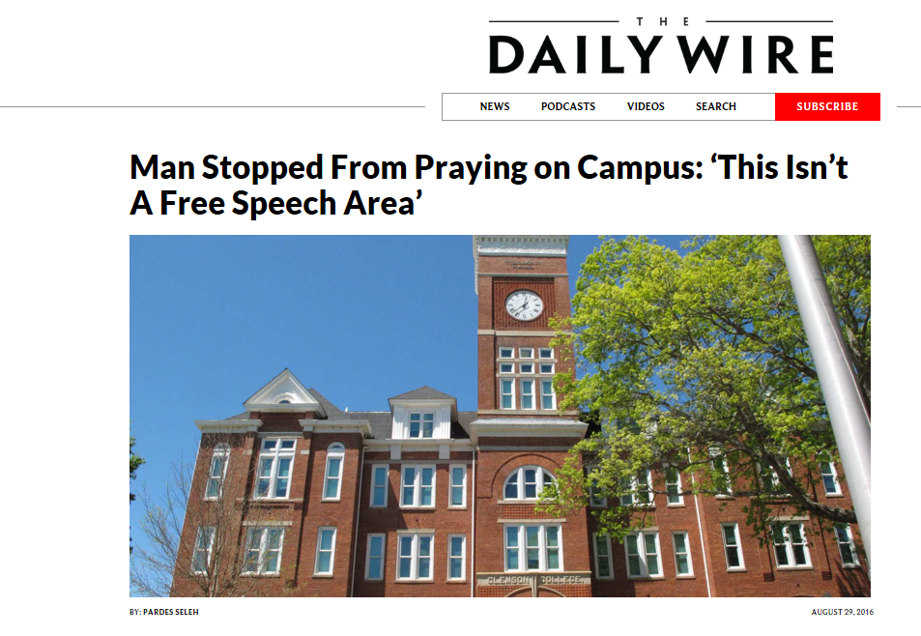
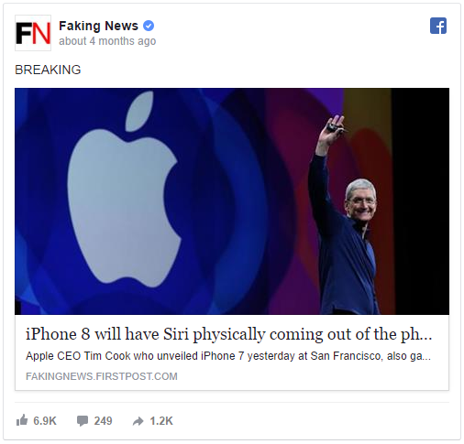
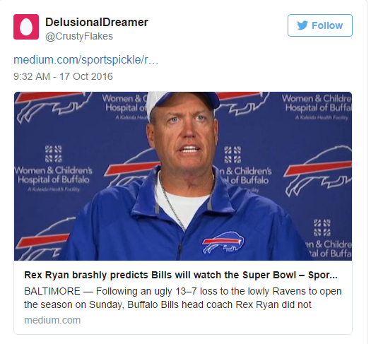
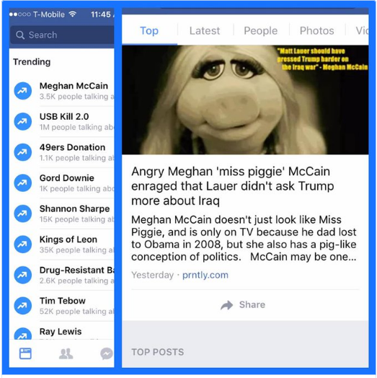
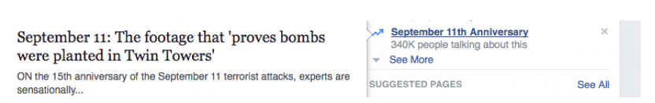
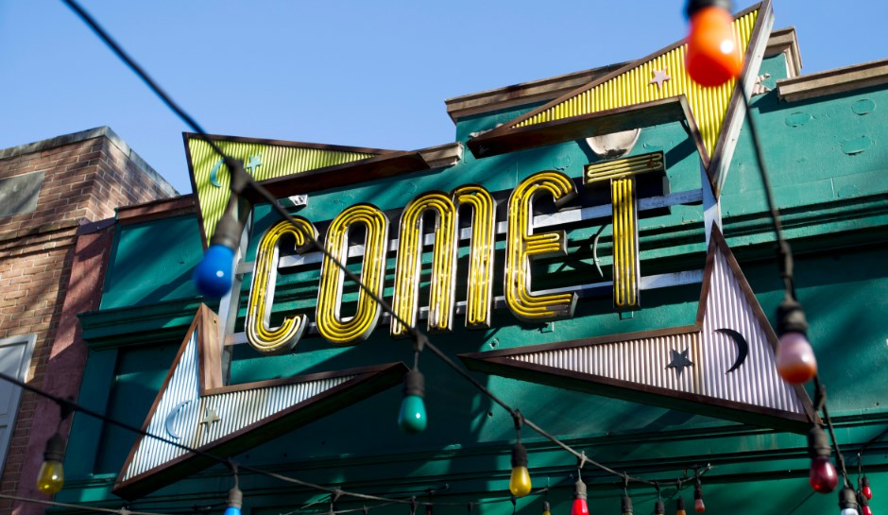
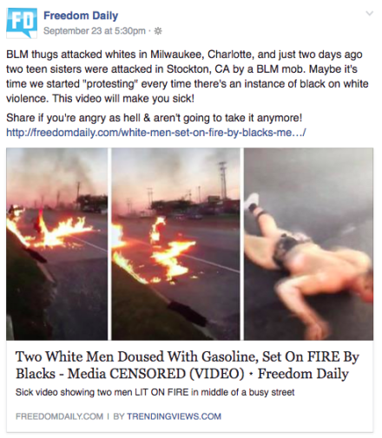
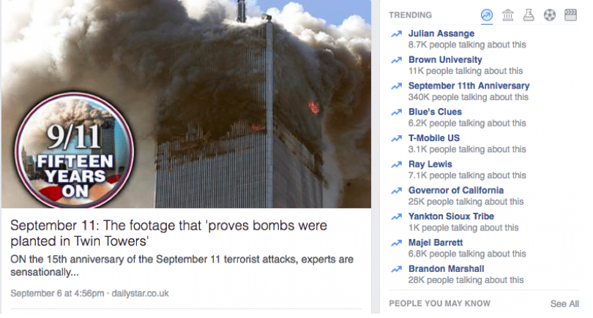
Notes:
In the six weeks following the Megyn Kelly incident, the site repeatedly promoted “news” stories that were totally fake news and fake news sites continued to grow and grow. While most of these were fairly inconsequential, some, like Pizzagate, became real world problems.
Details:
As part of a larger audit of Facebook’s Trending topics, the Intersect logged every news story that trended across four accounts during the workdays from Aug. 31 to Sept. 22. During that time, they uncovered five trending stories that were indisputably fake and three that were profoundly inaccurate. On top of that, we found that news releases, blog posts from sites such as Medium and links to online stores such as iTunes regularly trended. Facebook declined to comment about Trending on the record.
Some examples:
There was the thinly-sourced story, on Aug. 31, of a Clemson University administrator who kicked a praying man off campus. (The sordid tale, aggregated by a right-wing outlet, has been soundly debunked by the school.)
The next week, on Sept. 8, Facebook promoted a breathless account of the iPhone’s new and literally magical features, sourced from the real news site Firstpost’s satirical Faking News page.
The day after, Facebook trended a news release from the “Association of American Physicians and Surgeons” — a discredited libertarian medical organization — as well as a tabloid story claiming that the Sept. 11 attacks were a “controlled demolition.”
But if users thought the outrage about Facebook’s 9/11 truthering would prompt some reform in Trending, they were mistaken: Less than a week later, Facebook boosted a story about the Buffalo Bills from the well-established satirical site SportsPickle.
And in late September, Freedom Daily, a Facebook page with more than 1 million fans, scored a viral hit with a post that filled its audience with racial outrage. The post linked to an article on the Freedom Daily website with the headline “Two White Men Doused With Gasoline, Set On FIRE By Blacks – Media CENSORED (VIDEO).” The text that accompanied the link on Facebook connected the attack to recent Black Lives Matter protests and urged people to share the post “if you’re angry as hell & aren’t going to take it anymore!” But nowhere in the article or Facebook post did Freedom Daily make it clear that this incident happened almost a year ago, and that it had absolutely no connection to Black Lives Matter. The falsehoods continued from there: The altercation was actually between two people, a black man and his co-worker — and perhaps most importantly, the co-worker is not white. Court documents allege that the fight began with the co-worker throwing the first punch. Prosecutors also said the second man caught fire as a result of him coming into contact with the first man who was engulfed in flames. And finally, in spite of the headline’s claim that the incident was “CENSORED” by the media, it was widely covered by Baltimore media as well as by CNN and the Daily Mail’s website. (The man who allegedly set the fire, Christopher Harrison Jr., was charged with attempted first-degree murder, reckless endangerment, and first- and second-degree assault.) But these details only stood in the way of success on Facebook. In the end, Freedom Daily’s largely false post was shared more than 14,000 times, generating more than 9,000 reactions and over 2,000 angry comments on Facebook.
https://www.washingtonpost.com/news/the-intersect/wp/2016/10/12/facebook-has-repeatedly-trended-fake-news-since-firing-its-human-editors/?utm_term=.6561044fa98e
http://heavy.com/tech/2016/10/facebook-trending-fake-news-stories-fire-human-editors-fact-checking-2016-presidential-election-social-media-media-conspiracy-theories/
https://www.buzzfeed.com/craigsilverman/partisan-fb-pages-analysis?utm_term=.rbnW3mxk5y#.dyzkAPayqM

Slide 10
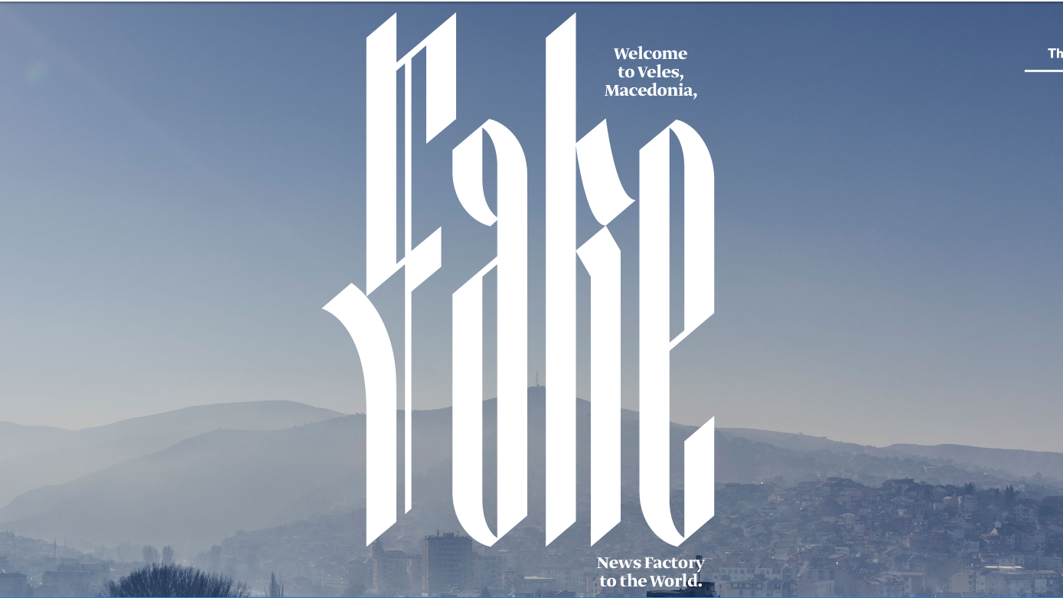
Notes:
Where were these stories coming from? Turns out, a lot of them came from … Macedonia. Of course, there are plenty of US-based fake news sites and Russian bots, but as these stories continued to trend, The Guardian, Buzzfeed, and Wired all completed separate investigations to see where these stories originated.
https://www.wired.com/2017/02/veles-macedonia-fake-news/?utm_source=nextdraft&utm_medium=email

Slide 11
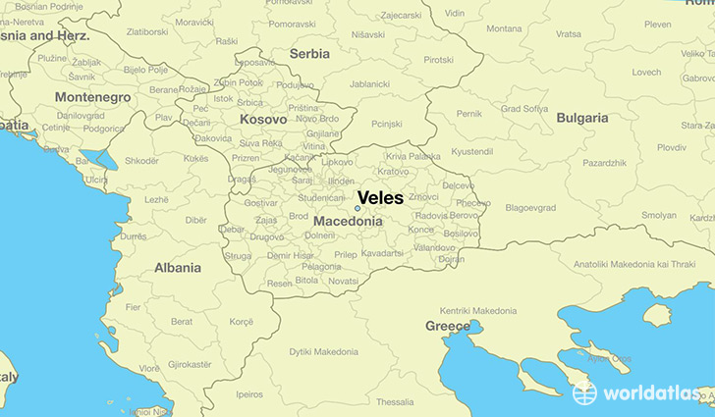
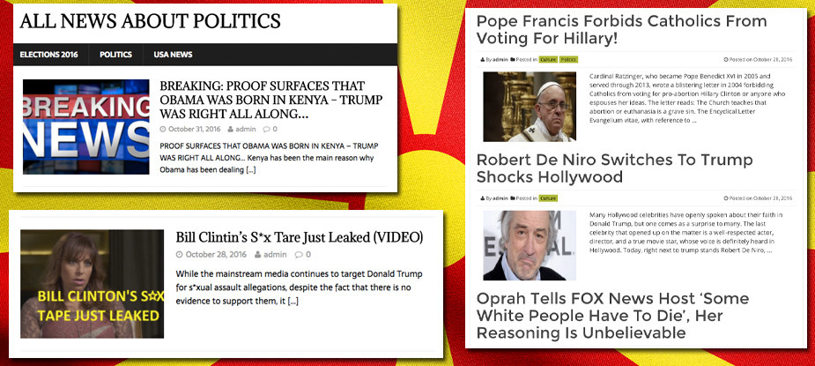
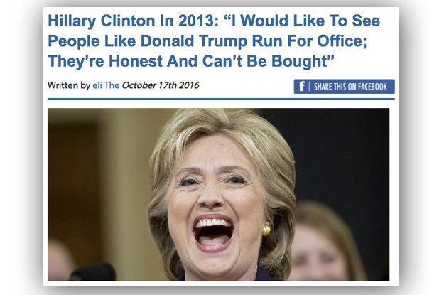
Notes:
At least 140 fake news sites about US politics were launched from Veles.
Details:
These sites have American-sounding domain names such as WorldPoliticus.com, TrumpVision365.com, USConservativeToday.com, DonaldTrumpNews.co, and USADailyPolitics.com. They almost all publish aggressively pro-Trump content aimed at conservatives and Trump supporters in the US.
Why Macedonia? And specifically, why Macedonian teens, who are the primary owners of these sites? It’s not because they care about Donald Trump. They are responding to straightforward economic incentives: As Facebook regularly reveals in earnings reports, a US Facebook user is worth about four times a user outside the US. The fraction-of-a-penny-per-click of US display advertising — a declining market for American publishers — goes a long way in Veles. Several teens and young men who run these sites told BuzzFeed News that they learned the best way to generate traffic is to get their politics stories to spread on Facebook — and the best way to generate shares on Facebook is to publish sensationalist and often false content that caters to Trump supporters.
As a result, this strange hub of pro-Trump sites in the former Yugoslav Republic of Macedonia is now playing a significant role in propagating the kind of false and misleading content that was identified in a recent BuzzFeed News analysis of hyperpartisan Facebook pages.
https://www.buzzfeed.com/craigsilverman/how-macedonia-became-a-global-hub-for-pro-trump-misinfo?utm_term=.scmbLnNE8D#.gay0AZyMWJ

Slide 12
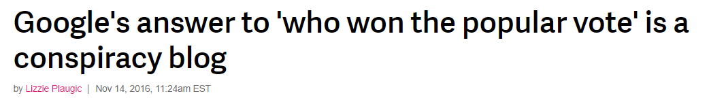
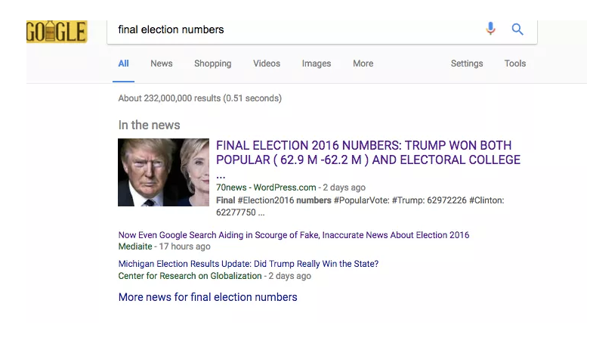
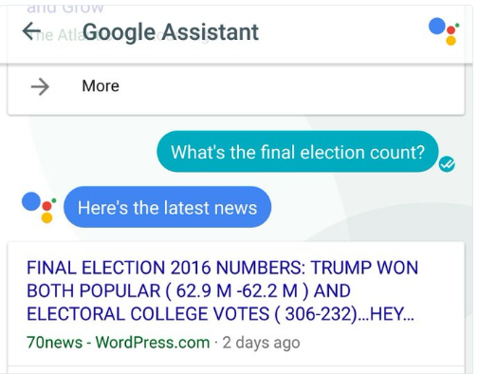
Notes:
And it’s not just Facebook, despite it feeling like they are at the center of the fake news universe, or standalone fake news sties. Google surfaced a fake news site with fake news results about the popular vote on the day after the election, including using the results in Google Assistant.
http://www.theverge.com/2016/11/14/13622566/google-search-fake-news-election-results-algorithm

Slide 13


Notes:
Real people DO care. In fact, 88% of Americans say that fake news has caused some or a great deal of confusion about the basic facts of current events.
http://www.journalism.org/2016/12/15/many-americans-believe-fake-news-is-sowing-confusion/

Slide 14

Notes:
And these stories, whether created by Americans, Macedonian teens, or others, have big impact. About 1/3 of Americans surveyed by Pew Research say they “Often” see made-up political news online. Over half report often seeing news online that is “not fully accurate”. While this is self-reported, and definitions of what is fake could vary, it is telling that people are saying they see it this frequently.
http://www.journalism.org/2016/12/15/many-americans-believe-fake-news-is-sowing-confusion/

Slide 15
The average U.S. adult was exposed to approximately 1-5 fake news articles in the months before the election.
1.2% of people actually recalled seeing the average fake news story, and even less believed the story.
156 articles flagged as fake news got 38 million Facebook shared by late November 2016.
At 20 page visits/share, that equals 760 million page visits.
Fake news websites got 159 million impressions during election month.
Source: Social Media and Fake News in the 2016 Election, Allcott and Gentzkow, New York University/Stanford/NBER, March 2017
Notes:
And the reason people report seeing it so often: because there’s a lot out there. A lot. Tons.
This study, from researchers at NYU and Stanford, used a two-pronged methodology to study and quantify how much fake news people see. The first part was the creation of a fake news database, comprised of fact-checked articles from Snopes, Politifact, and Buzzfeed lists. The second part was a 1200 person survey done after the election, weighted for national representation, where people were asked about their recall and belief of fake news. One study found that the average American adult saw between 1-5 fake news stories in October 2016, leading up to the election. That may not seem like a lot in the grand scheme of things, but when you consider that some people saw way more (and some way less), it is hard to deny that fake news can have an impact.
http://web.stanford.edu/~gentzkow/research/fakenews.pdf
https://www.bloomberg.com/view/articles/2017-01-23/the-numbers-are-in-fake-news-didn-t-work

Slide 16



Notes:
And like you just saw, these stories, whether created by Americans, Macedonian teens, or others, have big engagement impact. Multiple studies showed that fake news posts on social media (in this case Facebook), got higher engagement than real news stories from mainstream outlets during critical months of the presidential campaign.
https://www.buzzfeed.com/craigsilverman/viral-fake-election-news-outperformed-real-news-on-facebook?utm_term=.cym6vV3wNJ#.tsOrRO7o1M

Slide 17



Notes:
The problem is: it’s still happening. It’s not just the election that drove this. This story broke at the end of February. A history professor shared an experience with Google’s feature snippets surfacing information from a fake news site. “TheTrentOnline” is “Nigeria’s leading internet newspaper.” His tweet set of a firestorm, with big pieces from The Outline and Buzzfeed, among others, asking Google how this could happen.

Slide 18
“Featured Snippets in Search provide an automatic and algorithmic match to a given search query, and the content comes from third-party sites. Unfortunately, there are instances when we feature a site with inappropriate or misleading content. When we are alerted to a Featured Snippet that violates our policies, we work quickly to remove them, which we have done in this instance. We apologize for any offense this may have caused.”
Notes:
Here’s Google’s response…

Slide 19





How we consume news has changed
Notes:
So we’ve seen what has happened– how fake news has spread and why it’s a big deal. But there are other factors at play that indicate WHY we’ve become so susceptible to fake news– here are just a few:
How we consume news has changed, shifting largely to social media as a main source, as well as finding sources that suit our personal beliefs
Algorithms have replaced editors, especially at Facebook and Google, allowing fake news to surface
Simple design platforms, like Google’s AMP and Facebook Instant Articles, as well as simple web page creators, make it easy for fake news to look real
“The media,” the enemy of the state, has had a hard time figuring out how to cover fake news, incorrect statements, lies, etc.
On top of that, trust in major institutions (including the media) and in the idea of truth itself is at an all time low
And we aren’t innocent– we’ve created filter bubbles for ourselves that we just don’t want to burst, making it easier than ever to believe fake news that supports our beliefs
So, what do we do about it? Who’s doing anything?

Slide 20
More than seven-in-ten U.S. adults follow national and local news somewhat or very closely – 65% follow international news with the same regularity.
Fully 81% of Americans get at least some of this news through websites, apps or social networking sites.
And, this digital news intake is increasingly mobile. Among those who get news both on desktop computers and mobile devices, more than half prefer mobile.
(“The Modern News Consumer,” Journalism.org)
Notes:
It’s no surprise that we get our news differently today. Digital innovations, from the internet to mobile, have given us new channels and modes to get news. We have a constant stream of information at our fingertips, with seemingly fewer gatekeepers and hyper levels of immediacy. Stories and news comes in piecemeal, as headlines or links or shares, and we focus on what matters to us, even if that’s not the whole picture.
http://www.journalism.org/2016/07/07/the-modern-news-consumer/

Slide 21
How we consume news has changed
Algorithms replaced editors
Notes:
So we’ve seen what has happened– how fake news has spread and why it’s a big deal. But there are other factors at play that indicate WHY we’ve become so susceptible to fake news– here are just a few:
How we consume news has changed, shifting largely to social media as a main source, as well as finding sources that suit our personal beliefs
Algorithms have replaced editors, especially at Facebook and Google, allowing fake news to surface
Simple design platforms, like Google’s AMP and Facebook Instant Articles, as well as simple web page creators, make it easy for fake news to look real
“The media,” the enemy of the state, has had a hard time figuring out how to cover fake news, incorrect statements, lies, etc.
On top of that, trust in major institutions (including the media) and in the idea of truth itself is at an all time low
And we aren’t innocent– we’ve created filter bubbles for ourselves that we just don’t want to burst, making it easier than ever to believe fake news that supports our beliefs
So, what do we do about it? Who’s doing anything?

Slide 22


Notes:
In August 2016, just a few months after Mark’s post, Facebook announced a major algorithm change that would focus content on UGC, not publishers. Many in the media seemed surprised, both from news and business perspectives. Some felt like this was an admirable step in starting to battle the hoaxes popping up on the site. Others found it to be strange and confusing.
Oh, and they fired all the editors. Who needs them when their algorithm is this strong?
https://www.nytimes.com/2016/08/05/technology/facebook-moves-to-push-clickbait-lower-in-the-news-feed.html
https://www.nytimes.com/2016/06/30/technology/facebook-to-change-news-feed-to-focus-on-friends-and-family.html?smid=tw-nytimes&smtyp=cur&_r=

Slide 23


How we consume news has changed
Algorithms replaced editors
Simple design platforms make fake news look real
Notes:
So we’ve seen what has happened– how fake news has spread and why it’s a big deal. But there are other factors at play that indicate WHY we’ve become so susceptible to fake news– here are just a few:
How we consume news has changed, shifting largely to social media as a main source, as well as finding sources that suit our personal beliefs
Algorithms have replaced editors, especially at Facebook and Google, allowing fake news to surface
Simple design platforms, like Google’s AMP and Facebook Instant Articles, as well as simple web page creators, make it easy for fake news to look real
“The media,” the enemy of the state, has had a hard time figuring out how to cover fake news, incorrect statements, lies, etc.
On top of that, trust in major institutions (including the media) and in the idea of truth itself is at an all time low
And we aren’t innocent– we’ve created filter bubbles for ourselves that we just don’t want to burst, making it easier than ever to believe fake news that supports our beliefs
So, what do we do about it? Who’s doing anything?

Slide 24



Notes:
Snapchat and Apple News have managed to avoid the fake news firestorm. Why? In large part because of human interference. (Remember that last point?)
Both Snapchat Discover and Apple News use proprietary platform designs to publish content from their publishing partners. However, neither platform has automated this process, instead relying on human editors and curators to shepherd content through the process. Both platforms also maintain an approved publisher list that requires serious vetting before earning a spot.
https://www.buzzfeed.com/nitashatiku/snapchat-fake-news?utm_term=.hi5KkPVDWm#.mcm29LOeaA

Slide 25


Notes:
Facebook and Google operate differently. Both have in-house publishing platforms to format content to their respective styles– AMP for Google and Instant Articles for Facebook. But the difference here is that these platforms are almost fully automated. “Publishers” are less vetted and it’s easier for fake news to appear right in line with real news.
This is also a challenge because of engagement levels. An increasing volume of readers experience articles through these mobile masks. AMP now represents 10 to 15 percent of publisher search traffic, according to an October Define Media report. Facebook claims that Instant Articles content gets more traffic and deeper engagement than regular posts, with a 20 percent increase in average read time and a 30 percent higher share rate (those numbers are slightly suspect given Facebook’s control over exposure and its habit of misreporting data).

Slide 26

How we consume news has changed
Algorithms replaced editors
Simple design platforms make fake news look real
“The media” isn’t sure how to handle “fake news”
Notes:
So we’ve seen what has happened– how fake news has spread and why it’s a big deal. But there are other factors at play that indicate WHY we’ve become so susceptible to fake news– here are just a few:
How we consume news has changed, shifting largely to social media as a main source, as well as finding sources that suit our personal beliefs
Algorithms have replaced editors, especially at Facebook and Google, allowing fake news to surface
Simple design platforms, like Google’s AMP and Facebook Instant Articles, as well as simple web page creators, make it easy for fake news to look real
“The media,” the enemy of the state, has had a hard time figuring out how to cover fake news, incorrect statements, lies, etc.
On top of that, trust in major institutions (including the media) and in the idea of truth itself is at an all time low
And we aren’t innocent– we’ve created filter bubbles for ourselves that we just don’t want to burst, making it easier than ever to believe fake news that supports our beliefs
So, what do we do about it? Who’s doing anything?

Slide 27
“What I think is so unsettling about the fake news cries now is that their audience has already sort of bought into this idea that journalism has no credibility or legitimacy. Therefore, by applying that term to credible outlets, it becomes much more believable.”
(Angelo Carusone, president of Media Matters)
Notes:
And because of it, because of their model of “false balance” and the words they’ve chose to use, their credibility continues to wane. Sure, plenty of people still tune into the evening news or read their local paper. But fake news exists, in large part, because it’s been easier to not call it out and to call it something else.
https://mobile.nytimes.com/2016/12/25/us/politics/fake-news-claims-conservatives-mainstream-media-.html

Slide 28

How we consume news has changed
Algorithms replaced editors
Simple design platforms make fake news look real
“The media” isn’t sure how to handle “fake news”
Trust in institutions is at an all-time low
Notes:
So we’ve seen what has happened– how fake news has spread and why it’s a big deal. But there are other factors at play that indicate WHY we’ve become so susceptible to fake news– here are just a few:
How we consume news has changed, shifting largely to social media as a main source, as well as finding sources that suit our personal beliefs
Algorithms have replaced editors, especially at Facebook and Google, allowing fake news to surface
Simple design platforms, like Google’s AMP and Facebook Instant Articles, as well as simple web page creators, make it easy for fake news to look real
“The media,” the enemy of the state, has had a hard time figuring out how to cover fake news, incorrect statements, lies, etc.
On top of that, trust in major institutions (including the media) and in the idea of truth itself is at an all time low
And we aren’t innocent– we’ve created filter bubbles for ourselves that we just don’t want to burst, making it easier than ever to believe fake news that supports our beliefs
So, what do we do about it? Who’s doing anything?

Slide 29

Notes:
A clear indicator of our lack of trust: This.
Oxford Dictionaries has selected “post-truth” as 2016's international word of the year, after the contentious “Brexit” referendum and an equally divisive U.S. presidential election caused usage of the adjective to skyrocket, according to the Oxford University Press.
The dictionary defines “post-truth” as “relating to or denoting circumstances in which objective facts are less influential in shaping public opinion than appeals to emotion and personal belief.”
https://www.washingtonpost.com/news/the-fix/wp/2016/11/16/post-truth-named-2016-word-of-the-year-by-oxford-dictionaries/?utm_term=.5fe11e3a654d

Slide 30

Notes:
Other studies confirm that the public’s trust in media is low. While 76% say they have some level of trust in national news orgs, that’s lower than both family/friends/acquaintances and than local news orgs. And only 18% say they have a lot of trust in national news.
Social media doesn’t fare much better. Only 34% say they trust the information they get from social media.
When those who get news online from each source type were asked specifically about each’s accuracy, news organizations again sit at the top; 15% of those who get news from news organizations online find them very accurate, compared with 7% who say the same about people they are close with and just 2% for people they are not particularly close with.
Democrats are more likely than others to have “a lot” of trust in the information from national news organizations: 27% do, compared with 15% of Republicans and 13% of Independents. Those ages 50+ (22%) are also more likely than those ages 18-29 (10%) and those 30-49 (16%) to trust information from national news organizations a lot.
http://www.journalism.org/2016/07/07/trust-and-accuracy/

Slide 31

How we consume news has changed
Algorithms replaced editors
Simple design platforms make fake news look real
“The media” isn’t sure how to handle “fake news”
Trust in institutions is at an all-time low
We don’t want to burst our filter bubbles
Notes:
So we’ve seen what has happened– how fake news has spread and why it’s a big deal. But there are other factors at play that indicate WHY we’ve become so susceptible to fake news– here are just a few:
How we consume news has changed, shifting largely to social media as a main source, as well as finding sources that suit our personal beliefs
Algorithms have replaced editors, especially at Facebook and Google, allowing fake news to surface
Simple design platforms, like Google’s AMP and Facebook Instant Articles, as well as simple web page creators, make it easy for fake news to look real
“The media,” the enemy of the state, has had a hard time figuring out how to cover fake news, incorrect statements, lies, etc.
On top of that, trust in major institutions (including the media) and in the idea of truth itself is at an all time low
And we aren’t innocent– we’ve created filter bubbles for ourselves that we just don’t want to burst, making it easier than ever to believe fake news that supports our beliefs
So, what do we do about it? Who’s doing anything?

Slide 32



Notes:
In fact, partisanship has been one the biggest blame getters in the fake news story. This article from the New York Times talks in length about how our deep political biases are creating a kind of “partisan prism for facts,” making it easier to accept fake news if it fits the reality we want to be true.
https://www.nytimes.com/2017/01/11/upshot/the-real-story-about-fake-news-is-partisanship.html

Slide 33
“We’re in a highly-polarized, partisan time. It’s very hard to find a union between Democrats and Republicans. So if you think about it, who’s the authority when it comes to fact-checking? Finding a non-partisan, independent authority that can say this is true and this is false is very difficult today.”
(Adam Berinsky, a political science professor at MIT)
Notes:
http://www.salon.com/2017/02/05/this-is-your-brain-on-fake-news-whats-behind-the-human-willingness-to-swallow-alternative-facts/

Slide 34
What’s Being Done About It?

Slide 35

Notes:
We’ve got to do something. Many Americans expect social networking sites, politicians and the public itself to do their share to deal with fake news.
Fully 45% of U.S. adults say government, politicians and elected officials bear a great deal of responsibility for preventing made-up stories from gaining attention, on par with the 43% that say this of the public and the 42% who say this of social networking sites and search engines.
Although the overall portion of Americans who place responsibility on each is about equal, individuals have different perspectives on how that responsibility should be distributed.
Just 15% of Americans place a great deal of responsibility on all three of these groups, while a majority (58%) feels instead that one or two of them bear a great deal of responsibility.
While each of these three groups was seen as responsible by about an equal share of the public, it is not the case that every American thinks each bears a great deal of responsibility. In fact, only 15% of U.S. adults say this of all three groups, while 58% named one (31%) or two (27%) of the three groups.
http://www.journalism.org/2016/12/15/many-americans-believe-fake-news-is-sowing-confusion/

Slide 36


Notes:
Google and Facebook have said they’ll ban fake news sites from using their ad networks, cutting off the monetizing opportunity.
And so far, it’s going…ok. Both have implemented various checks to weed out these sites, to mixed and minimal effect.

Slide 37

Notes:
In a statement, Google said it reviewed 550 sites “suspected of misrepresenting content to users, including impersonating news organizations,” taking action against 340 and kicking over 200 publishers off the platform permanently. However, many are questioning the efficacy of this move, as over 2 million publishers use the platform. Others are criticizing Google for not calling these fake news sites, instead referring to them as sites that deceive users by misrepresenting content. Google also changed the language in its advertising policy to remove the words “fake news,” creating additional criticism.
https://blog.google/topics/ads/how-we-fought-bad-ads-sites-and-scammers-2016/

Slide 38

Notes:
More than 60 websites publishing fake news are earning revenue from advertising networks and most of them are working with major networks such as Revcontent, Google AdSense, and Content.ad, according to a review by BuzzFeed News.
It shows that in spite of calls for the digital ad industry to crack down on fake news and fraud in its ecosystem, fake news publishers continue to find ways to earn money from major advertising networks.
https://www.buzzfeed.com/craigsilverman/fake-news-real-ads?utm_term=.it8GpM9BDj#.lrPARXMDbe

Slide 39

Notes:
https://theoutline.com/post/1192/google-s-featured-snippets-are-worse-than-fake-news
Google doesn’t always get tripped up like this. Many of its answers, like the date of Mother’s Day, come from what Google calls its Knowledge Graph, a database of hard facts sourced from places like Wikipedia and CIA World Factbook. Google started implementing these in 2012, and they’re very reliable.
But a faster-growing number of quick answers, like the cake recipe and the Monty Python joke and the presidents supposedly in the Klan, are not as carefully curated. These answers are algorithmically generated from web pages that rank highly in the search results. They’re officially called “featured snippets.”
Google added featured snippets sometime in 2014, and it’s not like the company doesn’t know about this problem. In 2015, users discovered that the query “What happened to the dinosaurs?” produced the quick answer “Dinosaurs are used more than anything else to indoctrinate children and adults in the idea of millions of years of earth history,” pulled from a fundamentalist Christian page titled “What Really Happened to the Dinosaurs?” Google didn’t comment, but the featured snippet changed to a quote from the University of Illinois Extension.
Google has an excellent reputation, and it’s well-deserved. Mammoth forces of spammers, scammers, and other bad actors are constantly trying to manipulate Google’s search rankings, and yet they remain incredibly useful for users. Yet the company seems willing to take hits to its reputation while also promoting conspiracy theories, bigotry, and misinformation. Why?
For one thing, people really like this style of search. “It’s having a very good impact on the search results. People love them,” said Eric Enge, CEO of Stone Temple Consulting, a digital marketing agency that has done three deep-dive studies on featured snippets. In one of his company’s surveys, people said the feature they wanted most was the ability to “answer directly without having to visit another website or another app.” These quick answers are great when they’re accurate, especially if you’re on a mobile device, and they often are accurate — or at least accurate enough to satisfy the searcher.
Focusing on direct answers is also a longer-term play. The number of browser-less internet-connected devices is growing fast, and already voice-activated assistants like Amazon Echo and Google Home are penetrating the market. Google’s traditional list of search results does not translate well to voice — imagine Google Home reading you a list of 10 websites when you just want to know how many calories are in an orange.
“There’s data out there that suggests by the year 2020, which is only three years away, that 75 percent of internet-connected devices will be something other than a PC, smartphone, or tablet,” Enge said. “That 75 percent of connected devices will most likely interact by voice, and if you’re interacting by voice, and it responds in voice, you know how many answers you get? One. That’s only going to work if you have that answer.”
The fastest way for Google to improve its featured snippets is to release them into the real world and have users interact with them. Every featured snippet comes with two links in the footnote: “About this result,” and “Feedback.” The former explains what featured snippets are, with guidelines for webmasters on how to opt out of them or optimize for them. The latter simply asks, “What do you think?” with the option to respond with “This is helpful,” “Something is missing,” “Something is wrong,” or “This isn't useful,” and a section for comments.
Google uses this feedback form and other algorithmic signals from users to continuously improve and refine featured snippets. Snippets change a lot, Enge said — webmasters will optimize for a query, score a featured snippet, and then lose it days later. The system appears to work at least part of the time: On February 24, the query “MSG FDA” — my attempt to find the agency’s guidelines on MSG as part of fact-checking for this story — turned up a featured snippet from the MSG conspiracy theory website truthinlabeling.org. Within five days, that featured snippet had disappeared.
In theory, featured snippets will always temporarily turn up some bad answers, but the net effect would be better answers. “It’ll never be fully baked, because Google can’t tell if something is truly a fact or not,” said Danny Sullivan of Search Engine Land. “It depends on what people post on the web. And it can use all its machine learning and algorithms to make the best guess, but sometimes a guess is wrong. And when a guess is wrong, it can be spectacularly terrible.”

Slide 40

Notes:
An example of Google’s Featured Snippet issue…

Slide 41

Notes:
https://blog.google/products/search/fact-check-now-available-google-search-and-news-around-world/

Slide 42

Notes:
With thousands of new articles published online every minute of every day, the amount of content confronting people online can be overwhelming. And unfortunately, not all of it is factual or true, making it hard for people to distinguish fact from fiction. That’s why last October, along with our partners at Jigsaw, we announced that in a few countries we would start enabling publishers to show a “Fact Check” tag in Google News for news stories. This label identifies articles that include information fact checked by news publishers and fact-checking organizations.
After assessing feedback from both users and publishers, we’re making the Fact Check label in Google News available everywhere, and expanding it into Search globally in all languages. For the first time, when you conduct a search on Google that returns an authoritative result containing fact checks for one or more public claims, you will see that information clearly on the search results page. The snippet will display information on the claim, who made the claim, and the fact check of that particular claim.
This information won’t be available for every search result, and there may be search result pages where different publishers checked the same claim and reached different conclusions. These fact checks are not Google’s and are presented so people can make more informed judgements. Even though differing conclusions may be presented, we think it’s still helpful for people to understand the degree of consensus around a particular claim and have clear information on which sources agree. As we make fact checks more visible in Search results, we believe people will have an easier time reviewing and assessing these fact checks, and making their own informed opinions.
For publishers to be included in this feature, they must be using the Schema.org ClaimReview markup on the specific pages where they fact check public statements (documentation here), or they can use the Share the Facts widgetdeveloped by the Duke University Reporters Lab and Jigsaw. Only publishers that are algorithmically determined to be an authoritative source of information will qualify for inclusion. Finally, the content must adhere to the general policies that apply to all structured data markup, the Google News Publisher criteria for fact checks, and the standards for accountability and transparency, readability or proper site representation as articulated in our Google News General Guidelines. If a publisher or fact check claim does not meet these standards or honor these policies, we may, at our discretion, ignore that site's markup.

Slide 43

Notes:
Example of Schema.org…

Slide 44


Notes:
Speaking of Facebook, as the biggest platform in this battle, what else are they doing?
Their first tactic: distract! Facebook is pushing non-NewsFeed products, like Messenger and Facebook Live, to try and downplay the issues with News Feed and Trending. Those ads about Facebook Live? They exist because fake news exists. They are also doubling down on drones, Free Basics, etc.– anything but fake news and the News Feed.
Of course, it’s not just about distraction. Facebook is also hoping to get people to reengage with the platform and share more personal content. So the push to other features is as much about that, and is why Messenger and Bots are getting big play.
And they’ve done a few fake-news-specific things: they started a Journalism Project to forge better relationships with publishers. They hired Campbell Brown to be a liaison to the press. And Mark keeps posting statements like the one here to update what they are doing with the algorithm to fix it.
http://nymag.com/selectall/2016/12/whats-facebook-going-to-do-after-fake-news.html?mid=twitter_selectall
https://mobile.nytimes.com/2017/01/11/technology/facebook-journalism-project.html?smid=tw-nytimes&smtyp=cur

Slide 45


Notes:
Facebook has made (more) changes to its algorithm, and has implemented a fact checking project using third-party fact-checkers.
Of course, that requires Facebook users to report fake news and even then, they are just marking it as “disputed,” which literally means debated, which is not really that helpful.
https://www.buzzfeed.com/craigsilverman/facebook-and-fact-checkers-fight-fake-news?utm_term=.epO0lbvykz#.cwwPXqYOgv
https://www.nytimes.com/2016/12/15/technology/facebook-fake-news.html?_r=0

Slide 46

Notes:
https://techcrunch.com/2017/04/06/facebook-puts-link-to-10-tips-for-spotting-false-news-atop-feed/
Facebook came into this problem because of the poor news literacy, skepticism and proactive research behavior patterns of the modern news reader. According to studies, more than half of U.S. adults get their news from social media rather than directly from trusted sources, the majority of students can’t reliably distinguish fake news from real news and 20 percent of users on social media say that they’ve changed a social or political stance because of social media.

Slide 47
Notably, Facebook is not labeling these stories "fake" or "false." It's using the euphemistic term "disputed," which literally means "debated.“
Notes:
Except there’s one small problem: it’s not really effective. We’ve already talked about how fact-checking in general doesn’t work if the audience doesn’t care.
But there’s more to it, and it has to do with the language that Facebook is choosing: Disputed Posts.
If a story is found to be fake, the story will still be shareable, but it will be marked as "disputed" whenever it’s displayed on the platform—as well as flagged to someone the moment directly before she shares in hopes that she'll think twice about sharing. Notably, Facebook is not labeling these stories "fake" or "false." It's using the euphemistic term "disputed," which literally means "debated.“
And it’s being rolled out conservatively. Facebook tells us that the company will be flagging only the most obvious posts for Poynter to fact check. When asked what would happen to politically sensitive stories that were less outrageous but perhaps just as dangerous—like hyperpartisan headlines that question the scientific consensus of climate change—a Facebook spokesperson said the company had to be careful and keep Facebook a place where all people feel like they could have conversations most important to them.
Which gets to the real dilemma facing Facebook as it considers design solutions to the problem of fake news. On one hand, Facebook argues that it is not a media company. It recently even fired its editorial staff largely to avoid claims of bias, letting algorithms manage news instead.
But Facebook is a media company. Through those algorithms, it makes personalized, editorial decisions every time you open its app or website—whether you see a friend’s baby photos or a story from Breitbart. And the company is not transparent about how the algorithms work.
In this regard, relying on a third party fact checker could prove too little too late. Stories can go viral in minutes, and Facebook admits to not yet knowing how long the fact-checking process will take. The user interface will only be as effective as the speed with which real assessments are made. Furthermore, while Facebook will flag stories as disputed to users, truth doesn't seem impact how often Facebook's algorithms share a story—nor will multiple disputes all leading to a single publication weigh down its prioritization across feeds. In other words, even if Fast Company publishes five individual stories in one week that fact checkers flag as disputed, Facebook still won't curtail the spread of Fast Company stories at large. Each story is treated as an isolated incident.
Finally, Facebook’s UI is making one critical assumption: That people will believe Facebook enough to question their own beliefs—or the depressing believability of fake news itself. Because ultimately it’s Facebook’s UI that's flagging a story as disputed. And if you are prone to believe a Denver Guardian headline more than Facebook or Poytner? That "disputed" flag might just serve as confirmation for the liberal media bias. People are known to weigh "facts" supporting their world view more than those that question it—right or wrong, it's a basic psychological phenomenon that Facebook must account for in its design. Which is why it's so irresponsible that Facebook is hedging by labeling fake news "disputed" rather than "false." The use of the word "disputed" treats the facts themselves as if they're up for debate, which is precisely the mentality driving fake news and the post-truth era.
https://www.fastcodesign.com/3066630/here-is-facebooks-first-serious-attempt-to-fight-fake-news

Slide 48


Notes:
Facebook recently expanded the fact checking to Europe as well.

Slide 49

Notes:
And at the end of January, Facebook announced yet another change to its algorithm to show more authentic and timely stories, again trying to focus on people as opposed to publishers.
https://news.fastcompany.com/facebook-is-changing-its-news-feed-to-promote-posts-that-arent-fake-or-sensational-4029762

Slide 50



Notes:
http://mashable.com/2017/03/04/facebook-fa
Spotted on Twitter
on Friday night (March 5 2017), the tool identifies links to sites known to produce misinformation. The tool cites third-party fact-checking organizations like Snopes and Politifact—the kind of sites that Trump supporters also like to disputeke-news-rollout/?utm_cid=mash-com-Tw-main-link#_6CD2Jbz8OqT

Slide 51

Notes:
https://newsroom.fb.com/news/2017/04/a-new-educational-tool-against-misinformation/
We know people want to see accurate information on Facebook – and so do we. False news and hoaxes are harmful to our community and make the world less informed. All of us have a responsibility to curb the spread of false news.
At Facebook we have been focusing on three key areas:
disrupting economic incentives because most false news is financially motivated;
building new products to curb the spread of false news; and
helping people make more informed decisions when they encounter false news.
As part of our ongoing efforts, we’ve worked in consultation with First Draft, a non-profit dedicated to improving skills and standards in the reporting and sharing of information online, to roll out an educational tool to help people spot false news. We’re featuring this tool at the top of News Feed for a few days to people on Facebook in 14 countries.
When people click on this educational tool at the top of their News Feed, they will see more information and resources in the Facebook Help Center, including tips on how to spot false news, such as checking the URL of the site, investigating the source and looking for other reports on the topic.
News Feed is a place for authentic communication. Improving news literacy is a global priority, and we need to do our part to help people understand how to make decisions about which sources to trust.
False news runs counter to our mission to connect people with the stories they find meaningful. We will continue working on this and we know we have more work to do.
https://techcrunch.com/2017/04/06/facebook-puts-link-to-10-tips-for-spotting-false-news-atop-feed/

Slide 52



Notes:
White paper on internal operations to fight fake news
https://fbnewsroomus.files.wordpress.com/2017/04/facebook-and-information-operations-v1.pdf

Slide 53
“At the end of the day, if people want to share stories that have been flagged with their friends, that’s ultimately their prerogative.
We are making a very important point of not putting ourselves in a position of deciding what’s fake and not fake.
I don’t think people want us to be the arbiters of truth. There are third parties out there who do this for a living.”
(Dan Rose, Facebook vice president of partnerships)
Notes:
However, it doesn’t seem like Facebook is that committed to fixing the problem.
http://www.theverge.com/2017/2/14/14613102/facebook-fake-news-quote-sharing-flagged-stories-your-prerogative

Slide 54




Chrome Browser Extension
Notes:
Now, there are some other things happening to try and combat fake news, although most still trend towards fact checking.
Chrome extensions are being developed by regular people and media companies (here, the WashingtonPost and Slate) to provide real time warnings and fact checks on content.
http://nymag.com/selectall/2016/11/heres-a-browser-extension-that-will-flag-fake-news-sites.html
http://fortune.com/2016/12/18/trump-tweet-fact-check/

Slide 55



“Fake news has always existed, but online its impact is potentially boundless,” she told BuzzFeed News. “The most worrying aspect is that fake news, whether it’s driven by profit or as political propaganda, is all too often an antechamber to hate. “It is the combination between fake news that targets adversaries, and the hate this enables, that risk short-circuiting our democracies. It not only pollutes the debate, but it may distort how consensus is built.”
She added: “And in some cases, like the murder of the young Labour MP Jo Cox, the line between online and offline violence becomes very thin.”
Notes:
In December, the German Interior Ministry proposed creating a Center of Defense Against Misinformation, to help hunt down and eradicate fake news or other false information from the internet. The ministry has already told political parties to disable bots, technology that automatically shares news, tweets, and Facebook posts, saying those can be easily tricked into distributing propaganda. In fact, one German official has proposed fining Facebook 500,000 euros ($528,700) for failing to delete fake news stories and hate messages within 24 hours, describing the social media giant as a "value chain of digital propaganda."
The President of Italy’s Chamber of Deputies is launching a campaign to raise awareness about disinformation and its consequences.
And the UK Parliament is considering asking Facebook to self-police and add warnings to content deemed “fake news.”
http://www.csmonitor.com/World/Passcode/2017/0109/Germany-s-plan-to-fight-fake-news
https://www.buzzfeed.com/jimwaterson/british-mps-are-targeting-facebook-with-fake-news-inquiry?utm_term=.rkzrQjEnxJ#.kkpNqogR0Q

Slide 56



Notes:
And to break our own filter bubbles. Two interesting approaches are Buzzfeed’s DIY “Outside your bubble” feature and the “Last Week in Trump” newsletter.
Buzzfeed is deploying this tool on various stories to help readers get a broad perspective.
Sol Villarreal aims to help with “Last Week in Trump,” an email newsletter that aggregates news stories from mainstream, liberal and conservative sources so we can all understand what’s going on — and, hopefully, eventually, each other.
Hence, the tagline: “The Best of Both Bubbles.”
Each issue contains brief summaries and links to the top news stories of the week, culled from verified, mainstream sources like The New York Times, The Washington Post and The Wall Street Journal, but also conservative publications like The National Review, American Conservative, Red State and The Blaze.
“Having both gives you a more nuanced view of the world,” Villarreal said the other day, between travels across the internet and real-estate appointments around town. He’s an agent with Windermere, and works on the newsletter for about 20 hours a week.
A Field Guide to Fake News explores the use of digital methods to trace the production, circulation and reception of fake news online.
It is a project of the Public Data Lab with support from First Draft.
http://fakenews.publicdatalab.org/
http://www.seattletimes.com/seattle-news/last-week-in-trump-newsletter-aims-to-offer-the-best-of-both-bubbles/

Slide 57




Notes:
The public is also doing its part: A Merrimack College communications professor named Melissa Zimdars has released a simple Google Doc that lists “False, misleading, clickbait-y, and or satirical ‘news’ sources,” with a loose category system to help you determine the level of deceit you’re dealing with. It includes satirical sites like the Onion and the New Yorker’s Borowitz Report; misleading and hyperbolic clickbait like Infowars, Breitbart, and Political Blindspot; and fake sites that intentionally try to pass themselves as real ones, like MSNBC.com.co. Zimdars isn’t alone: The website Fake News Watch also lists categories of fake news sites to be on the lookout for, and New York magazine has created a Chrome extension that alerts the user to fake news sites based on Zimdar’s list.
http://www.vox.com/2016/11/16/13626318/viral-fake-news-on-facebook

Slide 58

Notes:
And while all of this is a start… it’s not really having that much impact. And we’ve got to do something fast. A recent article from Vanity Fair highlighted new technologies in audio and video manipulation that will make fake news even harder to identify.
http://www.vanityfair.com/news/2017/01/fake-news-technology

Slide 59
What can Bing do?
Notes:
So with all of that, why does this matter to Bing, and what can we do about it?

Slide 60
This is a start: being aware of the problem, how complicated it is, and that it’s not going away.
Understand the underlying factors that created this epidemic of fake news, from monetization to hyper-partisan filter bubbles. Are we enabling these?
Ensure that the search results and content we present to users meets a baseline of honesty and truth. Do we have the right checks in place to filter/flag fake news?
(Re)establish trust with users by being transparent about what we are doing to deal with fake news. Are we prepared if someone asks us about this?

Slide 61
Design Concepts for Fake News

Slide 62
We shared design concepts for fake news with 20 participants using a remote testing tool. Each participant had access to the design prototype and was able to click-through the designs to see various features.
9/20 participants either use a fact checker or actively fact check news stories. 11/20 do not.
14/20 participants agreed that search engines had a responsibility to help users identify fake news.
18/20 participants have not noticed fact checks on sites like Facebook or Google.

Slide 63


Over half of participants noticed the fact check tool without prompting.
The majority of users felt it would be a useful tool, but appreciated that it was optional.
Participants did feel that the colored dots could be larger to make them more noticeable, and asked for context about the fact check tag.

Slide 64

Participants overwhelmingly preferred the previous design, with the fact check after the source (instead of before it).
Participants felt it was less noticeable and easy to lose in this design.

Slide 65

Most participants liked the addition of the information icon, as it conveyed the ability to click to get additional context.
However, the gray text color was a bit difficult to see and didn’t stand out from the search results.

Slide 66

The majority of participants (70%) preferred seeing all fact checks – true and false – instead of just the false tags.
They felt that seeing all fact checks instilled a level of trust in the content and sources.

Slide 67

This fact check was nearly unnoticeable– 100% of participants felt that it was hard to find/see and preferred the earlier design options.
On top of that, while some participants appreciated the extra context, most were unsure about the source of the fact check and did not feel that this was credible.

Slide 68

Participants felt this design was more noticeable than the previous one, thanks to the header and the red dot.
Participants also felt that the information/context of the fact check was more clearly communicated.

Slide 69


Just over half (60%) of participants understood the hover/click treatment without a prompt.
Most participants found this design useful, as it provided information about why a result was fact checked and who did the fact checking. Some still questioned credibility and clarity, but most felt this was useful.

Slide 70


Most participants felt that this design was indistinguishable from the previous design.
However, some felt this copy was less clear and did not clearly explain why the fact checked news was deemed false.

Slide 71



Most participants (80%) did not notice the green flag icon on the first design until prompted. Participants did not understand that this icon was associated with a fact check.
Participants felt that the gray flag was slightly more understandable as a fact check alert, but still felt it wasn’t clear or noticeable.
Participants felt the list icon was the least associated with fact checking and again had issues noticing it.
Despite issues noticing these icons, when asked to choose a preference, the majority of participants opted for the green flat (70%).

Slide 72



Participants found the information pop-up to be somewhat useful to help them understand if a source was credible, although some still felt it was lacking context (as in previous examples).
Half of participants said they would use the “Don’t show me this source” tool.
The other half felt like they might use it sparingly or would not use it because they want to determine credibility on their own.

Slide 73



Participants were split on whether they preferred to hover on an icon or hover on the web link to activate the fact check pop-up.
Again, participants felt that the process to mute a source was easy and it was clear that the source was muted.

Slide 74




Most participants noticed and appreciated the highlighted link as a sign that something was not quite right with that result/source. The highlighting and red font were clear indicators to most participants.
Participants also appreciated the “See All My Muted Sources” feature, as a means of managing sources they may want to unmute in the future.

Slide 75




Participants liked the clarity in the messaging of this fake news tag, but had a harder time noticing it in the search results. The red font and icon were helpful in drawing attention to the alert.
Participants also felt that it was easy to mute the source, but that the feature was a bit lost in the search result and not as noticeable as other design options.

Slide 76
Of all the options presented, participants preferred the designs with the Fact Checked: True/False and the red/green dots. They felt these designs were the easiest to understand.
However, participants did ask to include the information icon alongside this design to provide additional context to the user about why/how an article was fact checked.
60% of participants said they would use and appreciate options like the ones provided in the study to help them identify fake news in search results.

Slide 77
Questions?

Slide 78
Thank You!

Slide 79
References and Resources

Slide 80
“Facebook Is Cracking Down on Viral Hoaxes. Really.”, Slate, 20 January 2015
“Former Facebook Workers: We Routinely Suppressed Conservative News,” Gizmodo, 9 May 2016
“Facebook’s Bias Is Built-In, and Bears Watching,” The New York Times, 11 May 2016
“Facebook Must Be Accountable to the Public,” Data & Society, 13 May 2016
“Social Media Finds New Role as News and Entertainment Curator,” The New York Times, 15 May 2016
“News Use Across Social Media Platforms,” Pew Research Center, 26 May 2016
“Facebook to Change News Feed to Focus on Friends and Family,” The New York Times, 29 June 2016
“The Modern News Consumer,” Pew Research Center, 7 July 2016
“The Case Against the Media, By the Media,” New York Magazine, 25 July 2016
“Shocker! Facebook Changes Its Algorithm to Avoid ‘Clickbait,” The New York Times, 4 August 2016
“Inside Facebook’s (Totally Insane, Unintentionally Gigantic, Hyperpartisan) Political-Media Machine,” The New York Times, 24 August 2016
“Trending Bad: How Facebook’s Foray into Automated News Went From Messy to Disastrous,” Slate, 30 August 2016
“Facebook Must Either Innovate or Admit Defeat at the Hands of Fake News Hoaxsters,” BuzzfeedNews, 30 August 2016
“10 Facts About the Changing Digital News Landscape,” Pew Research Center, 14 September 2016
“Facebook Has Repeatedly Trended Fake News Since Firing Its Human Editors,” Washington Post, 12 October 2016
“Hyperpartisan Facebook Pages Are Publishing False and Misleading Information at an Alarming Rate”, Buzzfeed, 20 October 2016
“How the Internet Is Loosening Our Grip on the Truth,” The New York Times, 3 November 2016
“How Teens in the Balkans Are Duping Trump Supporters with Fake News,” BuzzfeedNews, 3 November 2016
“Facebook, in Crosshairs After Election, Said to Question Its Influence,” The New York Times, 12 November 2016
“Despite Zuckerberg’s Protests, Fake News Does Better on Facebook Than Real News. Here’s the Data to Prove It,” Hapgood.us, 13 November 2016
“Renegade Facebook Employees Form Task Force to Battle Fake News,” BuzzfeedNews, 14 November 2016
“Google Will Soon Ban Fake News Sites from Using Its Ad Network,” TheVerge.com, 14 November 2016
“Google’s Answer to ‘Who Won the Popular Vote’ Is a Conspiracy Blog,” TheVerge.com, 14 November 2016
“Facebook Bans Fake News Sites from Using Its Advertising Network,” Wall Street Journal, 14 November 2016
“The Real Problem Behind the Fake News,” Slate, 15 November 2016

Slide 81
“The Scariest Part of Facebook’s Fake News Problem: Fake News Is More Viral than Real News,” Vox, 16 November 2016
“This Analysis Shows How Fake Election News Stories Outperformed Real News on Facebook,” BuzzfeedNews, 16 November 2016
“’Post-truth’ Named Word of the Year by Oxford English Dictionary,” Washington Post, 16 November 2016
“Obama, with Angela Merkel in Berlin, Assails Spread of Fake News,” The New York Times, 17 November 2016
“Facebook Fake News Writer: ‘I Think Trump Is In the White House Because of Me’”, Washington Post, 17 November 2016
“6 Types of Misinformation Circulated This Election Season,” Columbia Journalism Review, 18 November 2016
“How Fake News Goes Viral,” The New York Times, 20 November 2016
“How the 2016 Election Blew Up in Facebook’s Face,” BuzzfeedNews, 21 November 2016
“Fake News Is Not the Only Problem,” Data & Society, 22 November 2016
“We Tracked Down a Fake News Creator in the Suburbs. Here’s What We Learned,” NPR, 23 November 2016
“Why Snapchat and Apple Don’t Have a Fake News Problem,” BuzzfeedNews, 1 December 2016
“CNN Commentator Scottie Nell Hughes: Facts No Longer Exist,” The Washington Post, 1 December 2016
“Facebook and Google Make Lies As Pretty As Truth,” TheVerge.com, 6 December 2016
“Most Americans Who See Fake News Believe It, New Survey Says,” BuzzfeedNews, 6 December 2016
“As Fake News Spreads, More Readers Shrug at the Truth,” The New York Times, 6 December 2016
“Pizzagate: From Rumor to Hashtag to Gunfire in D.C.,” Washington Post, 6 December 2016
“What’s Facebook Going to Do After Fake News?,” New York Magazine, 7 December 2016
“Rocked by Fake News Crisis, Facebook Is Under Pressure To Open Up to Experts,” Buzzfeed News, 11 December 2016
“2016 Lie of the Year: Fake News,” PolitiFact, 13 December 2016
“Facebook Is Turning to Fact-Checkers to Fight Fake News,” BuzzfeedNews, 15 December 2016
“Many Americans Believe Fake News Is Sowing Confusion,” Pew Research Center, 15 December 2016
“Here is Facebook’s First Serious Attempt to Fight Fake News,” FastCoDesign, 15 December 2016
“Facebook Mounts Effort to Limit the Tide of Fake News,” The New York Times, 15 December 2016
“The Biggest UX Challenges of 2017,” FastCoDesign, 22 December 2016
“Wielding Claims of ‘Fake News,’ Conservatives Take Aim at Mainstream Media,” 25 December 2016
“The Problem With Self-Investigation in a Post-Truth Era,” The New York Times, 27 December 2016

Slide 82
“Fact-Checking Won’t Save Us From Fake News,” FiveThirtyEight, 4 January 2017
“Trump, ‘Lies,’ and Honest Journalism,” WSJ, 4 January 2017
“What’s Propaganda Got to Do With It?” Data & Society, 5 January 2017
“Did Media Literacy Backfire?” Data & Society, 5 January 2017
“How Do You Deal with a Problem Like Fake News?” Data & Society, 5 January 2017
“It’s Time to Retire the Tainted Term ‘Fake News’,” Washington Post, 8 January 2017
“Germany’s Plan to Fight Fake News,” Christian Science Monitor, 9 January 2017
“Facebook, Nodding to Its Role in Media, Starts a Journalism Project,” The New York Times, 11 January 2017
“Donald Trump and ‘Fake News’: An Important Reminder,” Mashable, 11 January 2017
“The Term Fake News Has Already Lost Its Meaning,” Flavorwire, 12 January 2017
“Flagging Fake News or Bad Sources Won’t Work,” Slate, 12 January 2017
“Lie to Me: Fiction in a Post-Truth Era,” The New York Times, 15 January 2017
“On Fake News,” EmptyWheel.net, 15 January 2017
“10 Times Donald Trump Spread Fake News,” The New York Times, 18 January 2017
“From Headline to Photograph, a Fake News Masterpiece,” The New York Times, 18 January 2017
“Did Fake News Help Elect Trump? Not Likely, According to New Research,” Poynter, 18 January 2017
“People Are Sharing Fake Pictures of Bikers for Trump Heading to the Inauguration,” Buzzfeed News, 19 January 2017
“Snapchat Discover Takes a Hard Line on Misleading and Explicit Images,” The New York Times, 23 January 2017
“The Right Is Building a New Media “Upside Down” To Tell Trump’s Story,” Buzzfeed News, 23 January 2017
“Your Brain Gives Up When Discerning Truth From Lies Gets Too Hard,” New York Magazine, 23 January 2017
“In Race Against Fake News, Google and Facebook Stroll to the Starting Line,” The New York Times, 25 January 2017
“How We Fought Bad Ads and Scammers in 2016,” Google, 25 January 2017
“Fake News Is About to Get Even Scarier Than You Ever Dreamed,” Vanity Fair, 26 January 2017
“This is a Great Psychological Framework For Understanding How Fake News Spreads,” New York Magazine, 27 January 2017
“Parliament Could Ask Facebook to Add “Fake News” Warnings to British News Stories,” Buzzfeed News, 29 January 2017
“IAB Chief Calls on Online Ad Industry to Fight Fake News,” Wall Street Journal, 30 January 2017

Slide 83
“Trumps Lies vs. Your Brain,” Politico, January/February 2017
“Facebook Is Changing Its News Feed to Promote Posts that Aren’t Fake or Sensational,” Fast Company, 1 February 2017
“Why Fake News Targeted Trump Supporters,” The Atlantic, 2 February 2017
“The Rise of Progressive ‘Fake News,’” The Atlantic, 3 February 2017
“Here’s What Facebook’s Live Video Filter Bubble Looks Like,” Buzzfeed News, 3 February 2017
“We Can’t Talk About Fake News If We Can’t Agree What It Means,” Recode, 3 February 2017
“The Massacre That Wasn’t, And a Turning Point for Fake News,” The New York Times, 5 February 2017
“This Is Your Brain on Fake News: What’s Behind the Human Willingness to Swallow ‘Alternative Facts,’” Salon, 5 February 2017
“Facebook Launches Fake News Filter in France,” TheVerge, 6 February 2017
“No, President Trump, Negative Polls Are Not Fake News,” CNN, 6 February 2017
“Democrats Confront Lefty Fake News,” Buzzfeed News, 6 February 2017
“A Story Trump Might Call ‘Fake News’ – If It Weren’t His Facebook Page Sharing It,” CNN, 6 February 2017
“Why the White House Keeps Crying Fake News,” Slate, 7 February 2017
“An Old Hoax Is Going Viral Again Thanks to Macedonian Pro-Trump Sites and Facebook Pages,” Buzzfeed News, 7 February 2017
“This Unemployed Guy Made Japanese Fake News and Ended Up Losing a Bunch of Money,” Buzzfeed News, 8 February 2017
“The President of Italy’s Chamber of Deputies Is Launching a Campaign Against Fake News,” Buzzfeed News, 8 February 2017
“You Are Now the Gatekeeper of the News,” Salon, 9 February 2017
“Want To Make A Lie Seem True? Say It Again. And Again. And Again.”, Wired, 11 February 2017
“A Hollywood Film Is Using Fake News to Get Publicity,” Buzzfeed News, 13 February 2017
“’Fake News’ Is Dead,” Columbia Journalism Review, 14 February 2017
“Facebook: Sharing Fake News Is Your Prerogative,” The Verge, 14 February 2017
“Inside the Macedonian Fake News Complex,” Wired, 15 February 2017
“20th Century Fox Gives Real Apology for a Fake News Campaign,” The New York Times, 16 February 2017
“Here’s Why Trump’s Attacks on ‘Fake News’ Succeed,” The Washington Post, 17 February 2017
“In An Age of Alternative Facts, A College Course on Calling Out Scientific Crap,” StatNews.com, 17 February 2017
“Europe Combats a New Foe of Political Stability: Fake News,” The New York Times, 20 February 2017
“Sweden Has No Idea Why Donald Trump Is Talking About the Country,” Salon, 20 February 2017

Slide 84
“We Avoid News We Don’t Like. Some Trump-Era Evidence,” The New York Times, 21 February 2017
“The Joys of Propaganda,” The New York Times, 22 February 2017
“Russia Launches Website Dedicated to Flagging “Fake News,”” The Verge, 23 February 2017
“The Real Definition of Fake News,” CNN/Reliable Sources, 26 February 2017
“Why Facts Don’t Change Our Minds,” The New Yorker, 27 February 2017
“This Is How Your Hyperpartisan News Gets Made,” Buzzfeed 27 February 2017
“False, Misleading, Clickbait-y, and/or Satirical “News” Sources,” Google Doc compiled by Melissa Zimdars, professor of communications at Merrimack College

